Slide 1

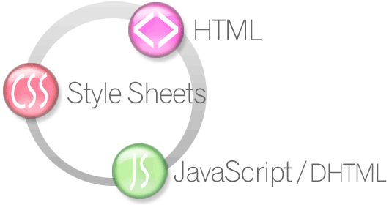


Twitter Bootstrap
Much cool, such easy, very CSS
ASP.NET MVC
Telerik Software Academy
http://academy.telerik.com

Slide 2

Table of Contents
Twitter Bootstrap
Grid System
Default CSS styles
Form
Buttons
Tables

Slide 3

Twitter Bootstrap

Slide 4

Bootstrap 3
Twitter Bootstrap
Download at: http://getbootstrap.com/
Responsive down to mobile
Complete CSS framework
Feature-rich
A lot of themes (free and paid)
Easy to use
There is also a famous 2.3.2 version

Slide 5

Bootstrap 3
Twitter Bootstrap Installation
Download at: http://getbootstrap.com/
Add bootstrap.min.css to your HTML
Add jQuery to your HTML
Add bootstrap.min.js below jQuery
Done!

Slide 6
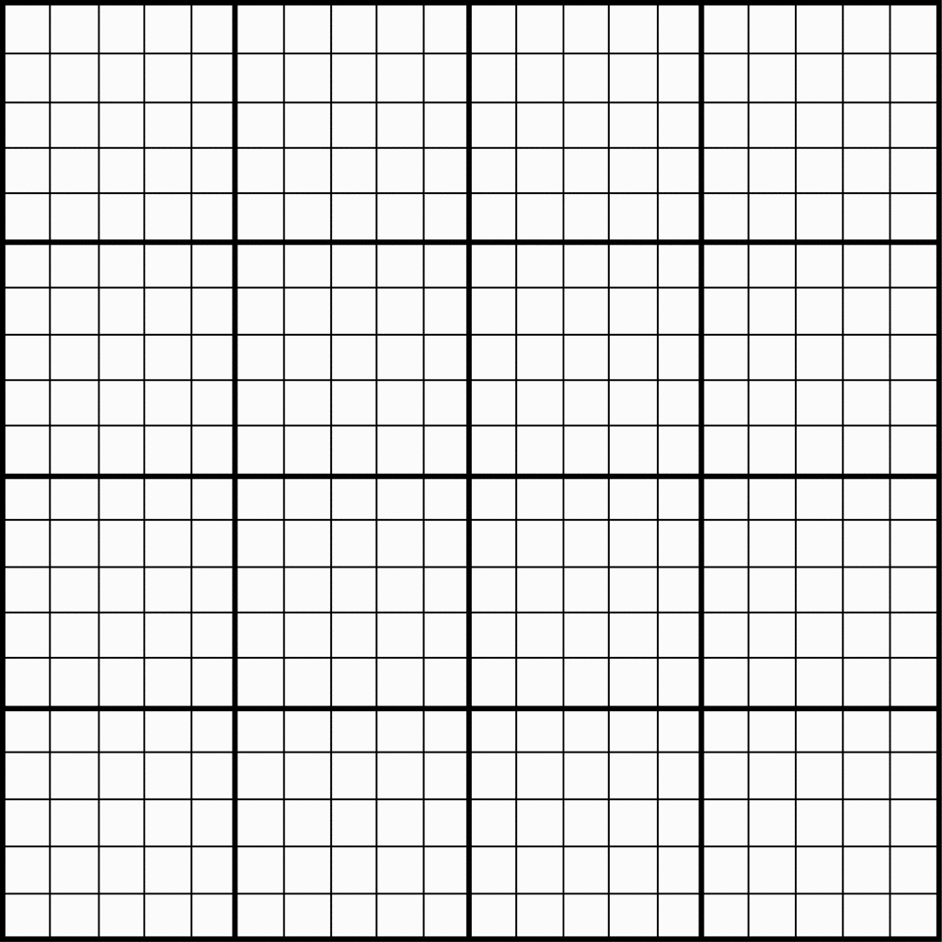
Bootstrap 3
Grid system
12 column-based grid system
.container class for grid wrapper
.row class for rows
.col-md-# for columns
Examples
http://getbootstrap.com/examples/grid/

Slide 7
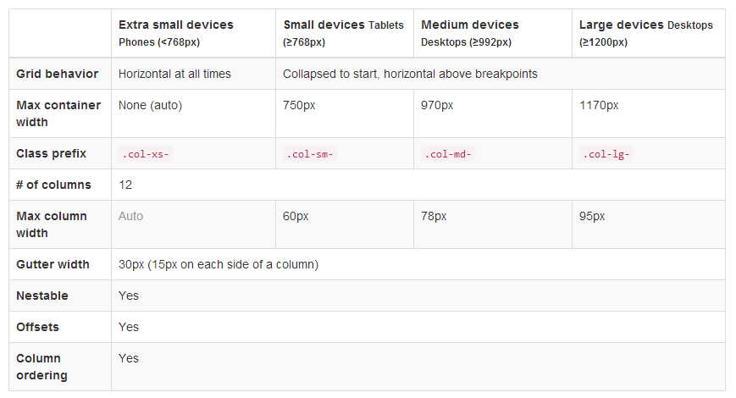
Bootstrap 3.0
Grid system options

Slide 8
Bootstrap Grid Example
Example
<div class="container">
<div class="row">
<div class="col-md-4">
<div class="border">1/3</div>
</div>
<div class="col-md-8">
<div class="border">2/3</div>
</div>
</div>
</div>

Slide 9
Bootstrap Grid
Live Demo

Slide 10

Bootstrap 3
Default Typography
Headings
Paragraphs (can add class .lead)
<small>, <em>, <strong>
Built-in alignment classes
.text-left
.text-center
.text-right

Slide 11

Bootstrap 3
Default Typography – text colors
.text-muted – grey
.text-primary – light blue
.text-success – green
.text-info – dark blue
.text-warning – yellow
.text-danger – red

Slide 12
Bootstrap Typography
Live Demo

Slide 13
Bootstrap 3
Tables - on <table> elements
.table – default table
.table-striped – every second row is colored
.table-bordered – adds border to a table
.table-hover – adds hover element to a table
.table-condensed – makes the table compact
Tables – on <tr> and <td> elements
.active, .success, .warning, .danger

Slide 14
Bootstrap Tables
Live Demo

Slide 15

Bootstrap 3
Forms
Add .form to the <form> element
Add .form-control to all form elements
Group them with .form-group
Buttons
.btn for buttons
.btn-primary, .btn-danger, … for colors
.btn-lg, btn-sm, btn-xs for sizes

Slide 16
Bootstrap Forms and Buttons
Live Demo

Slide 17

Bootstrap 3
Images
.img-rounded – for image with round edges
.img-circle – for image as circle
.img-thumbnail – adds small border
Helper classes
Close icon - .close on any button
Quick float - .pull-left, .pull-right

Slide 18
Bootstrap Images
Live Demo

Slide 19
Bootstrap Other
Live Demo

Slide 20
Twitter Bootstrap
http://academy.telerik.com

